Slide 1
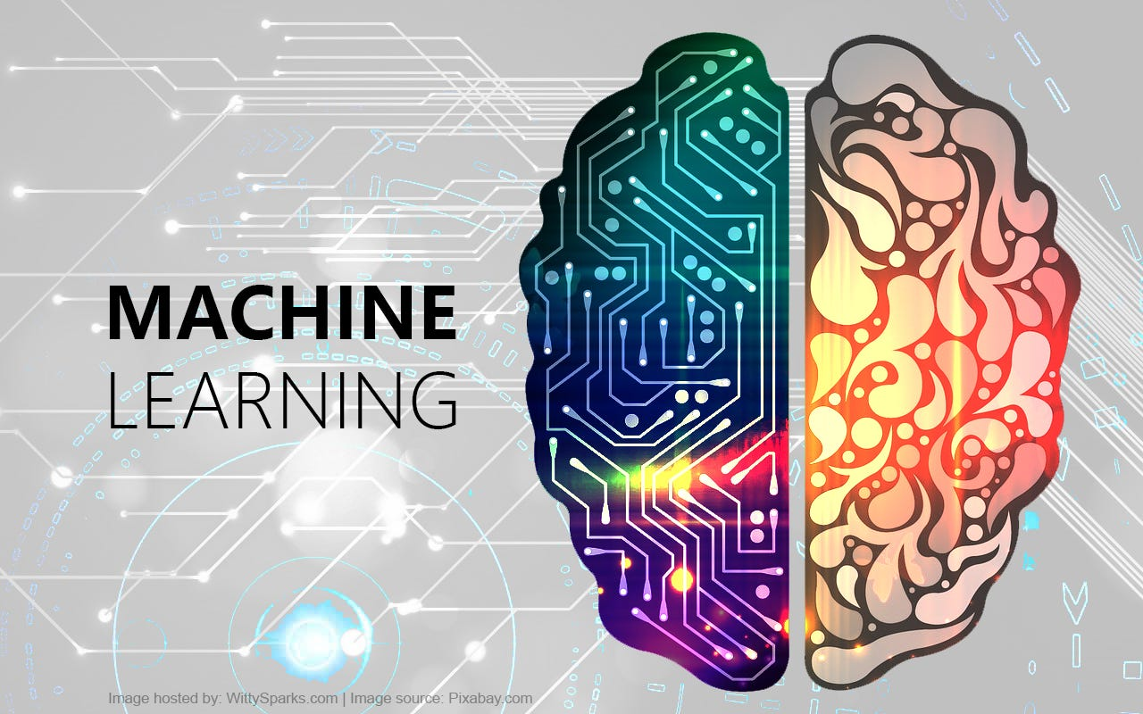
DFCS|DK|62|203
Data & Information Management
Research Report and Presentation

Slide 2

Table of Contents
Abstract…………………………………………………………………………………
Introduction……………………………………………………………………………..
Body
Analyzing Data and Spotting Patterns……………………………………………….
Identification and Protection of Anomalies ………………………………………….
Improving The Processing of Data…………………………………………. Prognostic Analytics and Guidance Assistance………………………………… Text mining and natural language processing…………………………
Possibilities and Difficulties ………………………………………………..
Conclusion……………………………………………………………………………
Reference………………………………………………………………………………

Slide 3

Abstract
In this study article, we uncover the revolutionary consequence of combining machine learning with databases and management, highlighting the tremendous synergy between both fields. The dynamic digital environment demands creative solutions in order to process, analyze and make decisions on data effectively. The integration of machine learning techniques with database management becomes essential to address these problems and transform data-centric paradigms.
The signification of efficient data processing is first discussed, with a focus on the limitations of traditional methods when working with large and intricate database. With the advent of ML algorithms, data preparation is automated, guaranteeing efficiency, accuracy and motivation based on historical data trends. This improvement also applies to data integration where ML-driven technologies are used to provide comprehensive data consolidation by expertly connecting disparate records. Data integrity is preserved by the resulting simplified data preparation.
Next we will examine pattern recognition and data analysis, where machine learning can aid in the understanding of huge datasets. Through the use of clustering techniques, hidden patterns in everything from social network connection to consumer segments can be found. Data is categorized using classification algorithms, which offer insights for a variety of uses like as personalized product recommendations and the detection of illnesses. The industry most impacted is e-commerce, which may use recommendation algorithms to boost user engagement.
As machine learning empowers businesses to take preventive measures, predictive analytics assumes a central role. Through its ability to estimate numerical values and guide strategic direction, regression analysis advance our understanding. Decision assistance systems powered by machine learning and historical data analysis enhance executives options, such as allocating resources and improving healthcare. Thus, empowerment based on data is applicable to many businesses.
Security and anomaly detection represent another domain in which machine learning finds use. Businesses in the banking and manufacturing industries are protected by the quick identification of deviations from established norms. While anomaly detection safe guards product quality by identifying defects before they affect consumers, intrusion detection systems enhance cybersecurity.
The study expands to look at text mining and natural language processing. The handling of unstructured textual data is revolutionized by machine learning techniques, which make sentiment analysis, content classification, and entity extraction possible. Top search engines use text mining powered by machine learning to enhance. The article’s purview has been broadened to include text mining and natural language processing ML approaches are used to convert unstructured textual data, allowing for entity extraction, content categorization and sentiment analysis. Leading search engines employ ML-driven text mining to enhance user search experiences.
Ultimately, data-driven paradigms are redefined when machine learning and database/data management are combined. The study presents a comprehensive analysis of how this mutually beneficial relationship facilitates companies, modifies decision-making processes and propels industries forward. With the potential for even more profound consequences and deeper integration as technology develops, machine learning’s status as a vital component of contemporary data management is assured.

Slide 4

Introduction
With the use of data and machine learning computers can now make predictions and decisions without explicit programming. ML is a game-changing technology. Data management and database systems are mutually dependent on this technology. Is noticeable. Efficient analysis, retrieval, storage and decision-making are crucial in today’s data-driven world when organizations must deal with massive datasets. There are important solution to these problems when machine learning techniques are integrated with database administration.

Slide 5

Analyzing Data and Spotting Patterns
Data analysis and pattern recognition enter a new age with the combination of ML and database administration. To uncover hidden features in data, clustering methods like hierarchical clustering and K-means clustering are essential. By combining similar data set, these techniques make tasks like social network research, customer profiling, and market segmentation easier.
Categorization algorithms are another essential component of ML-powered data analysis. Numerous applications are possible because to these algorithms ability to classify data items into predefined categories. Medical image classification is aided by machine learning models in the healthcare industry. In order to identify spam emails and enhance user experiences, email management uses classification algorithms.
Particularly ML-powered recommendation systems are vital to e-commerce. In order to predict preference and provide personalized product recommendations, these algorithms thoroughly analyze the browsing and purchase histories of their customers. Collaborative filtering techniques are utilized by amazon’s recommendation engine to enhance user engagement and boost sales.
What makes machine learning ML powered data analysis unique is its ability to process enormous datasets with subtle patterns that human analysts would overlook. By continuously improving and refining their models through data-driven learning algorithms guarantee that their conclusions will hold true over time. This adaptability is necessary in the world of today is data-rich, with growing data volume and complexity.
Finally, merging database management and machine learning allows us to draw deeper and more nuanced insights from data. Data classification and grouping algorithms reveal hidden patterns and let decision-makers in many domains make decisions more easily. Recommendation systems improve user experiences and promote sales in e-commerce. Deeper insights will be possible as we navigate the data-driven world thanks to the combination of machine learning and data analysis.

Slide 6

Identification and Protection of Anomalies
Data security is entering a new era as a result of the integration of machine learning (ML) and database management, which gives businesses a strong toolkit for anomaly detection and security bolstering. When there are deviations from established patterns, it's possible that important events or security breaches are being hinted at.
Anomaly detection may be automated with great success when using machine learning techniques. Regular activity observations allow models to promptly identify anomalies. For instance, ML systems in the finance sector inspect transaction data to find unusual spending trends and promptly alert customers to possibly fraudulent activity. Through the early identification of defective products, anomaly detection safeguards production quality control.
Cybersecurity is one of the main benefits of ML-driven intrusion detection systems. These systems carefully watch user behavior and network traffic to spot potential dangers and unauthorized access attempts. By immediately identifying unusual patterns and safeguarding sensitive information and digital assets, machine learning models improve the resistance against attacks.
But anomaly detection's importance goes beyond cybersecurity. By finding anomalies in patient data and medical images, machine learning (ML) helps in the early identification of illness in the healthcare industry. By identifying departures from expected transportation patterns, it ensures the integrity of goods while they are being transported in supply chain management.
However, even as ML increases security, it also presents new challenges. Adversarial assaults pose a significant risk because they involve hostile actors manipulating data to trick machine learning algorithms. For anomaly detection to remain effective in security applications, further study into adversary resistance is also essential.
To sum up, by integrating machine learning with database management, businesses may fortify existing security protocols and promptly identify irregularities. Data protection is enhanced by ML-driven anomaly detection, which ensures the confidentiality and integrity of important data in supply chain management, banking, cybersecurity, and other industries. The adaptability and durability of machine learning models are essential for safeguarding our digital environment as security threats evolve.

Slide 7
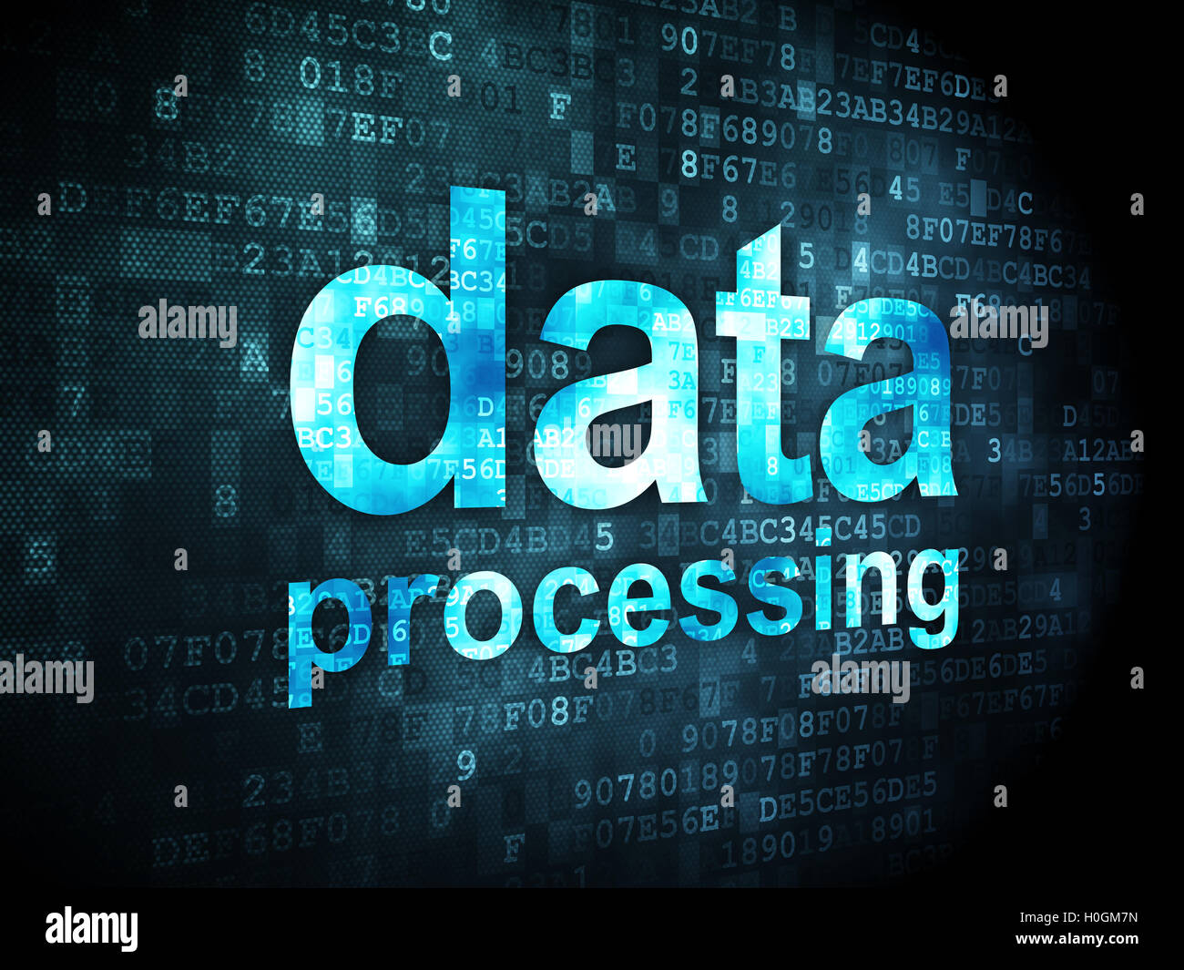
Improving The Processing of Data
Efficient data processing is essential for database and data management. Historically, conventional methods for data integration, transformation, and cleaning have taken a lot of time and human labor. In contrast, a paradigm shift in data processing is brought about by the integration of Machine Learning (ML) techniques into database administration.
ML algorithms demonstrate their power by ensuring accuracy and efficiency by automating data preparation activities. These algorithms find and quickly correct errors, duplication, and missing data in databases by utilizing past data trends as a reference. In the healthcare industry, for example, ML-driven data preparation has proven to be crucial for increasing the accuracy of electronic health records and, consequently, lowering errors that may negatively impact patient care..
Moreover, advanced data integration methods are another area where machine learning and database management are related. Through the use of probabilistic models and similarity criteria, ML-driven integration solutions skillfully link records from various datasets, producing thorough and reliable data consolidation. This combination expedites the process of preparing data while preserving its integrity.
There are extensive ramifications from this automated data processing. By releasing data engineers and analysts from the limitations of manual data integration and cleansing, it enables them to focus their time and resources on higher-level tasks. Businesses working with huge and diverse datasets will find this efficiency extremely helpful as it enables them to make informed decisions quickly.
Moreover, data integrity is preserved over the course of the data lifecycle using machine learning-driven data processing. This is crucial, especially in highly regulated industries like banking and healthcare where data privacy and accuracy are inalienable. In summary, data processing is transformed when database management and machine learning are combined. Automation of data preparation using machine learning not only expedites tasks but also enhances data quality, enabling businesses to make confident decisions based on data and laying the groundwork for effective data management.

Slide 8



Prognostic Analytics and Guidance Assistance
Predictive analytics driven by machine learning (ML) modifies decision-making by forecasting future results based on historical data trends. Regression analysis, a fundamental ML technique, models the relationships between variables to predict numerical values. For instance, it predicts property values in real estate based on amenities, size, and location, which affects investment decisions and pricing schemes.
With machine learning-enhanced decision support systems, predictive analytics is advanced. To identify trends and patterns that support data-driven decision-making, they look at historical data. Predicting patient readmission rates using machine learning (ML) helps healthcare organizations optimize resources and improve patient care. They support investment plans by analyzing market trends and financial risks.
The field of healthcare is a prime example of how predictive analytics can revolutionize. ML algorithms maximize hospital resources, identify illness outbreaks, and estimate the health trajectories of specific patients. Proactive treatments lead to improved patient outcomes and reduced costs. However, problems persist. Making sure the model is accurate and eliminating biases from the training set are constant concerns. Gaining confidence is largely dependent on interpretability, particularly in crucial domains like healthcare.
ML-driven predictive analytics and decision support, last but not least, are the engines that drive data-driven decision making. Companies in a variety of sectors utilize them to predict trends, make the most use of their resources, and enhance results. Machine learning is becoming more and more important in current decision support systems as a result of its capacity to offer practical insights and help well-informed decisions.

Slide 9
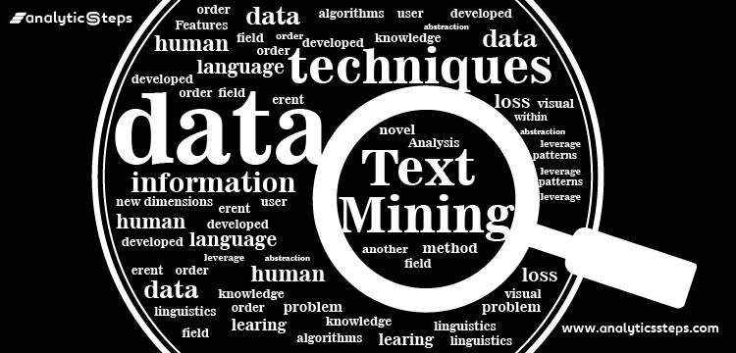
Text mining and natural language processing
The combination of machine learning (ML) and database management, along with Natural Language Processing (NLP) and Text Mining, has completely changed how unstructured textual data is processed. We explore the transformative potential of the technology in this part.
NLP techniques make it possible for computers to understand and interpret human language, opening the door for significant discoveries to be made from enormous textual databases. A common NLP technique is opinion analysis, which examines text data from social media and online reviews to ascertain what the general public thinks about certain goods, services, or political developments. Businesses utilize this sentiment research to gauge customer satisfaction and enhance marketing campaigns.
However, valuable information can be extracted from large text corpora using text mining algorithms. Included are entity extraction, content classification, and summarization. ML-driven text mining is a technique used by top search engines like Google to improve user experience by giving people relevant search results.
In order to identify new trends and enhance clinical decision support, medical literature and patient data are examined using NLP and text mining in the healthcare industry. These innovations simplify In the legal field, document analysis and legal research can save time and money. The complexity of language and context causes these technologies to be computationally expensive and dependent on vast amounts of training data, which is the source of the challenge. Concerns about prejudice and privacy in text data also bring up ethical issues..
Lastly, text mining and machine learning together have an impact on how firms use textual data. These tools, which encompass anything from information discovery to sentiment analysis, offer practical insights that enhance decision-making in many fields. With the increasing ability of machine learning algorithms to extract meaning and context from text, there is a great deal of opportunity for data-driven innovation and efficiency.

Slide 10

Possibilities
Distinctive Privacy: Methods such as differential privacy provide machine learning algorithms with an additional degree of privacy protection, ensuring the confidentiality of individual data.
Efficiency and automating: Time-consuming tasks like data preparation are automated by machine learning, which reduces human mistake and effort. Data experts can concentrate on higher-level tasks because to this efficiency.
Federated Education: Models can be trained on dispersed data sources while maintaining security and privacy thanks to this decentralized machine learning technique.
AI that can be explained: In order to help people comprehend and believe in the conclusions made by complex machine learning algorithms, explainable AI aims to make these algorithms more transparent and comprehensible.
Difficulties
Fairness and Bias: Training data biases have the potential to reinforce inequality in machine learning predictions. Addressing prejudice and ensuring fairness in algorithms are essential to prevent biased results.
Scalability: The ability of ML systems to effectively manage large datasets grows as data volumes rise. New methods and distributed computing are needed to solve this problem.
Data Security and Privacy Concerns: There are concerns about data security and privacy breaches because ML models often need sensitive data for training. To preserve this data while enabling model expansion is a difficult balance.
Interpretability and Explain ability: A lot of machine learning models, especially those that use deep learning, can be challenging to comprehend and interpret. In mission-critical applications like healthcare, it is essential to comprehend and provide reasoning for model decisions.
Ultimately, the challenges and possibilities presented by the marriage of database management and machine learning constitute the developing field of data-driven decision-making. Even though problems like bias and data privacy still exist, new approaches, increased transparency, and ethical considerations open the door to a time when machine learning will help us better extract valuable insights from data while upholding integrity and trust.

Slide 11

Conclusion
The symbiotic relationship between Machine Learning (ML) and database/data management has been the subject of an insightful investigation, highlighting the profound implications and ground-breaking potential of this union. The crucial importance of data management in contemporary businesses across multiple industries served as the foundation for our inquiry. Critical thinking, creativity, and competitiveness are all based on it. But the manual processes that characterize traditional data management systems have made them unable to handle the volume, diversity, and speed of modern data, which is growing at an exponential rate.
Machine learning (ML) is a potent tool that enhances and automates data management processes, revolutionizing the way we work with and derive value from data. Finding out how machine learning makes data processing simpler was the first step in our mission. It replaces labor-intensive data purification, transformation, and integration activities with precise and effective process automation. By maintaining data integrity and learning from historical data trends, machine learning (ML) rapidly identifies and fixes discrepancies. Better data integration methods are brought about by the combination of machine learning and database administration, which relieves the burden on data experts and frees them up to concentrate on more advanced tasks.
ML integration is a turning point in the big data era. It makes it easier for businesses to handle enormous volumes of unstructured data, which improves their capacity to extract insightful information. The benefits also extend to data integrity, since machine learning not only satisfies but beyond regulatory requirements, fostering confidence in decision-making based on data. As our journey went on, it became evident that machine learning was essential for both pattern recognition and data analysis. It offers classification and practical insights using clustering and classification methods. Important decisions are guided by predictive analytics, which makes predictions about the future, while machine learning-driven recommendation systems improve consumer satisfaction by anticipating user preferences.
The digital era's two cornerstones, anomaly detection and security, have greatly advanced as a result of machine learning. Whether used in banking, manufacturing, or cybersecurity, machine learning (ML) enhances data security by automating the detection of anomalies. With the help of text mining and natural language processing (NLP), which have transformed data processing by enabling computers to glean insights from unstructured text, it is particularly crucial.
However, our journey left us with a lot of issues. A major challenge with data privacy and security is the sensitivity of training data. The existence of biases in machine learning algorithms gives rise to questions of fairness and impartiality. Moreover, it can be challenging to interpret the decisions made by many machine learning models due to their opacity, especially in mission-critical applications. However, these problems act as catalysts for innovation, giving rise to approaches like federated learning and differential privacy in addition to projects aimed at improving the transparency and interpretability of machine learning models.

Slide 12

Vivek, J. (2023, May 25). Data Science & Machine Learning: Role of ML in Data SCEI. Zuci Systems.
Iqbal, K., & Khan, M. S. (2022). Email classification analysis using machine learning techniques.
Shepardson, B. (2023, June 1). The Power of Predictive Analytics in Real Estate: Unleashing the potential of Data-Driven Decision Making.
Sipes, T., Jiang, S. B., Moore, K. L., Li, N., Karimabadi, H., & Barr, J. R. (2014). Anomaly Detection in Healthcare: Detecting erroneous treatment plans in time series radiotherapy data.
Das, B. R., Sahoo, R., & Sahoo, A. K. (2023). Monitoring Social Media and Research Paper using Natural Language Processing.
GeeksforGeeks. (2023). Ethical considerations in natural language processing bias fairness and privacy.
Farah, L., Murris, J., Borget, I., Guilloux, A., Martelli, N., & Katsahian, S. (2023). Assessment of Performance, Interpretability, and Explainability in Artificial Intelligence–Based Health Technologies: What Healthcare Stakeholders Need to Know.
Solutions, C. (a.n.d.). What are some collaboration solutions that leverage AI or machine learning?
Morgan, A., & Edward, E. (2023). Enhancing Data Integrity in Banking Applications using AI/ML Techniques.
Di Stefano, A. (2022, August 3). Recommendation systems and machine learning: driving personalization.

